Slide 1
customs
Customs definition
Customs revenue in 1997 = 29 thousand billion tomans
Duties of customs:
Participation in business policies | Supporting domestic industries and productions | Collection of duties and customs duties
Supporting inventors and innovators | Fighting smuggling and customs violations | Protection of cultural and historical monuments
Fight against money laundering | Fighting terrorism and organized crime | Participation in regional and international cooperation
Preparation and presentation of foreign trade statistics | Providing business facilities | Application of foreign trade rules and regulations

Slide 2










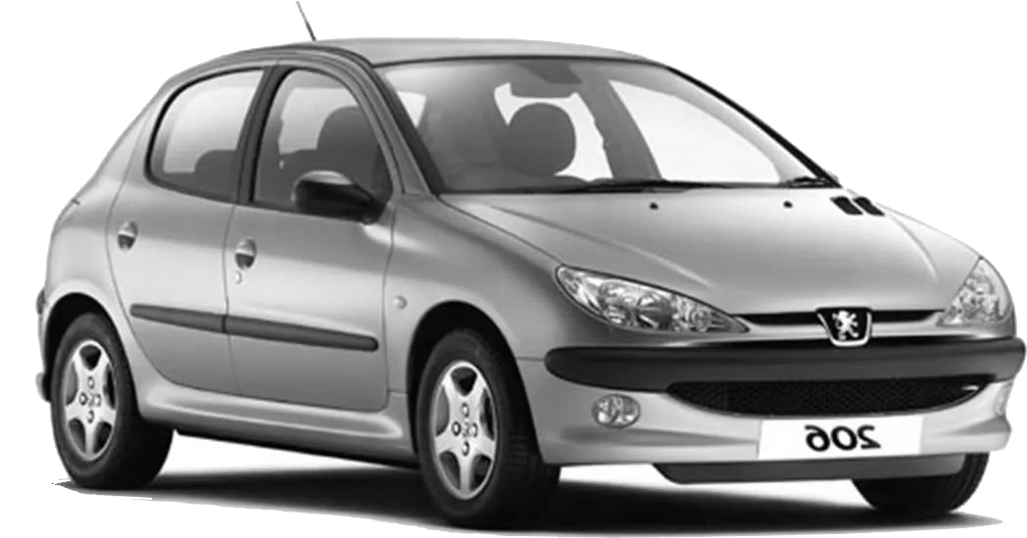
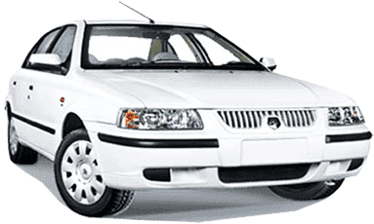
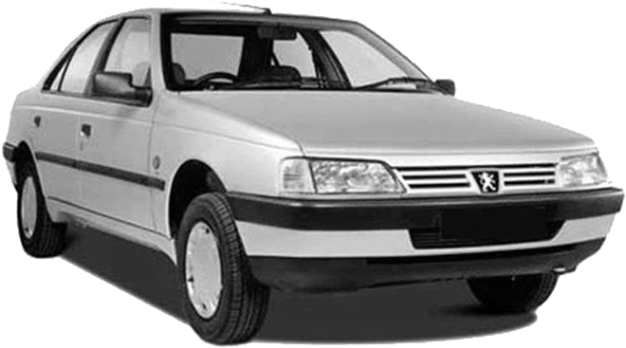
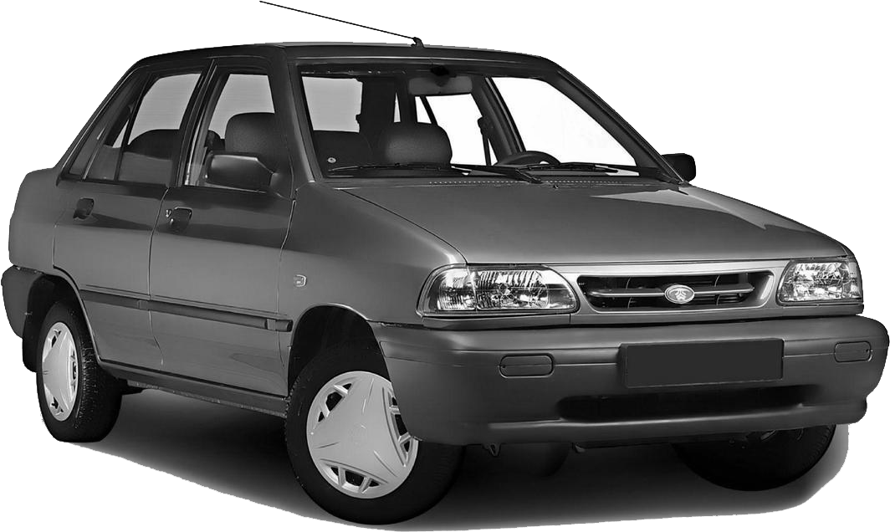
Car history
Tariff
1326
1346
1357
1359
1369
lack of competition
Oil prices
1373
Export and import regulation law
1380
1383
Tariff 120%
1384
100% tariff

Slide 3
Car history
$
1388
90% tariff
2012
Tariff 45%
2017
Therefore, for about half of this period
(from 1346 until now), the import of cars is prohibited
And the other half has an average tariff of more than 50

Slide 4
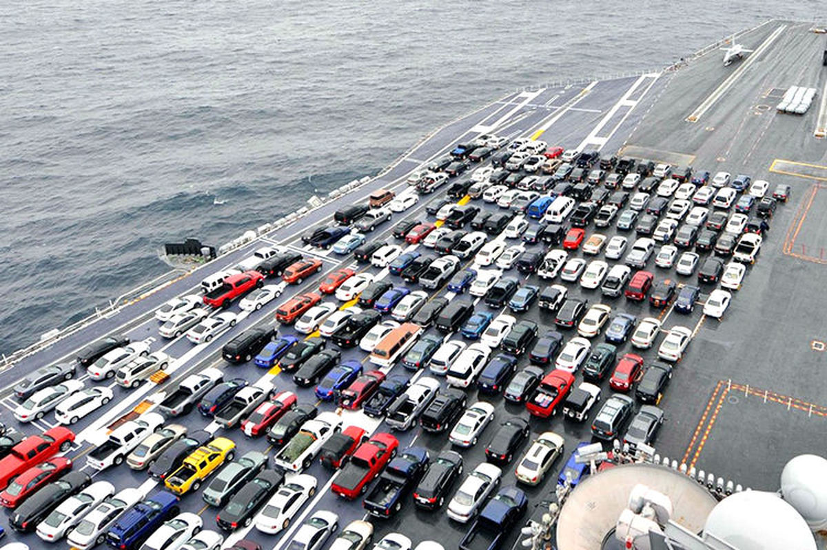
Define the problem
Basic definition of the problem
Do we have a strategic environment?
The importance of game theory in this
issue
Similar issues

Slide 5

Model
Players: Parliament and domestic producers
1- Entry of foreign cars
1- Parliament
2- Prohibition of entry of foreign vehicles
actions
1- Increasing the quality of production
2- Domestic car
manufacturer
2- Not changing the quality of production

Slide 6
Assembly
The amount of customs revenue from the tax on
foreign cars by choosing the entry of foreign cars into the parliament:
The domestic car manufacturer chooses to increase the quality of its production: C ₁
The domestic car manufacturer chooses not to change its production quality: C ₂
It is clear that if the Parliament chooses its second strategy (banning the import of foreign cars), in this
The form of this income will be zero regardless of the second player's strategy.
Experimental mode:
C ₂ > C ₁

Slide 7
Assembly
a: The level of satisfaction of the parliament with the decision to increase the quality of production by the domestic car manufacturer
Regardless of your strategy
S: The (slight) amount of regret of the parliament for choosing to increase
the quality of production by the domestic car manufacturer
and choosing the strategy of entering foreign cars by the Parliament

Slide 8
benefit of the parliament
Second player \ first player | Increase production quality | Not changing the quality of production
Entry of foreign vehicles | C ₁ +as | C ₂
Prohibition of entry of foreign vehicles | a | 0

Slide 9
Car manufacturer
The amount of direct income from the sale of manufactured cars of the car manufacturer:
The first player is the entry of foreign cars and the second player is the increase in production quality: D ₁₁
The first player is the entry of foreign cars and the second player is not changing the production quality: D ₁₂
The first player is to ban the entry of foreign cars and the second player is to increase the quality of production: D ₂₁
The first player banning the entry of foreign cars and the second player not changing the quality of production: D ₂₂
In the case that the first player chooses the strategy of banning
the entry of foreign cars, the market becomes practically monopolistic without competitors.
Experimental mode:
D ₁₁ - D ₁₂ > D ₂₁ - D ₂₂
D ₂₁ >D ₂₂ >D ₁₁ >D ₁₂

Slide 10
Car manufacturer
B: The cost of increasing the production quality of the domestic car manufacturer
Profit of the domestic car manufacturer:
Second player \ first player | Increase production quality | Not changing the quality of production
Entry of foreign vehicles | D ₁₁ -B | D ₁₂
Prohibition of entry of foreign vehicles | D ₂₁ -B | D ₂₂

Slide 11
Profit
Second player \ first player | Increase production quality | Not changing the quality of production
Entry of foreign vehicles | D ₁₁ -B and C ₁ +as | D ₁₂ and C ₂
Prohibition of entry of foreign vehicles | D ₂₁ -B and a | D ₂₂ and 0
In addition to his own decision, each player's profit also depends
on the other player's decision. (strategic environment)

Slide 12

simultaneous game

Slide 13
simultaneous game
Simultaneous play
Players : {government, car manufacturer}
Collection of actions of the parliament : {imports, prohibition of imports}
The automotive manufacturer's set of actions : {increasing quality, stable quality}
Preferences : We indicate the preference of the parliament with u ₁ and the preferences of the car manufacturer with u _{2 .}
u ₁ ( import , quality increase ) = C ₁ + a –s, u ₁ ( import ban , quality increase ) = a , u ₁ ( import , fixed quality ) = C ₂ , u ₁ ( import ban , fixed quality ) = 0
u ₂ ( import , quality increase ) = D ₁₁ - B , u ₂ ( import ban , quality increase ) = D ₂₁ - B, u ₂ ( import , fixed quality ) = D ₁₂ , u ₂ ( import ban , fixed quality ) = D ₂₂

Slide 14
simultaneous game
Display the matrix form of the game
q
car maker
1 - q
 | Increase quality | Consistent quality
Importation | $$C_{1}+a−s, D_{11}−B$$ | $$C_{2}, D_{12}$$
Import ban | $$a, D_{21}−B$$ | $$0, D_{22}$$
p
Assembly
1 - p
Note 1: In this form, decisions between the parliament and the car manufacturer are made simultaneously.
Note 2: The first number represents the decision of the parliament and the second number represents the decision of the car manufacturer.
: Numerical value of the parliament's desire to increase domestic production a reminder
: Amount of cost to increase car quality by car manufacturer B reminder
The most important influencing factors in choosing two players :
a, b, s
: Numerical value of the Parliament's shame in exchange for causing losses to the car manufacturer s reminder

Slide 15
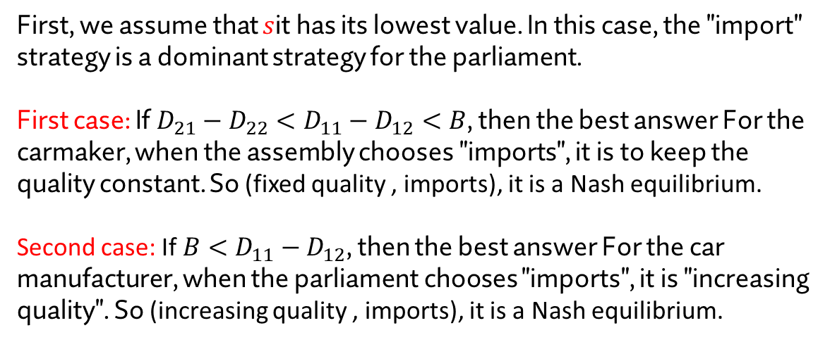
simultaneous game
Nash equilibria of the game
 | Increase quality | Consistent quality
Importation | $$C_{1}+a−s, D_{11}−B$$ | $$C_{2}, D_{12}$$
Import ban | $$a, D_{21}−B$$ | $$0, D_{22}$$
First, we assume that $s$it has its lowest value. In this case, the "import" strategy is a dominant strategy for the parliament.
First case: If $D_{21}−D_{22}<D_{11}−D_{12}<B$, then the best answer For the carmaker, when the assembly chooses "imports", it is to keep the quality constant. So (fixed quality , imports), it is a Nash equilibrium.
Second case: If $B<D_{11}−D_{12}$, then the best answer For the car manufacturer, when the parliament chooses "imports", it is "increasing quality". So (increasing quality , imports), it is a Nash equilibrium.

Slide 16
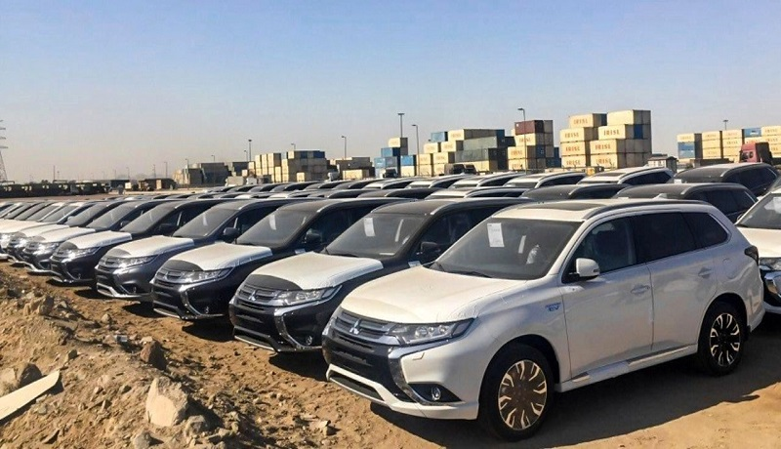
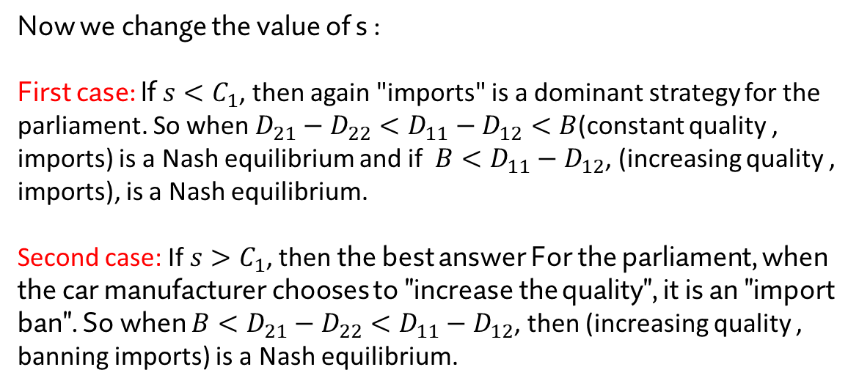
simultaneous game
Nash equilibria of the game
 | Increase quality | Consistent quality
Importation | $$C_{1}+a−s, D_{11}−B$$ | $$C_{2}, D_{12}$$
Import ban | $$a, D_{21}−B$$ | $$0, D_{22}$$
Now we change the value of s :
First case: If $s<C_{1}$, then again "imports" is a dominant strategy for the parliament. So when $D_{21}−D_{22}<D_{11}−D_{12}<B$(constant quality , imports) is a Nash equilibrium and if $B<D_{11}−D_{12}$, (increasing quality , imports), is a Nash equilibrium.
Second case: If $s>C_{1}$, then the best answer For the parliament, when the car manufacturer chooses to "increase the quality", it is an "import ban". So when ${B<D}_{21}−D_{22}<D_{11}−D_{12}$, then (increasing quality , banning imports) is a Nash equilibrium.

Slide 17
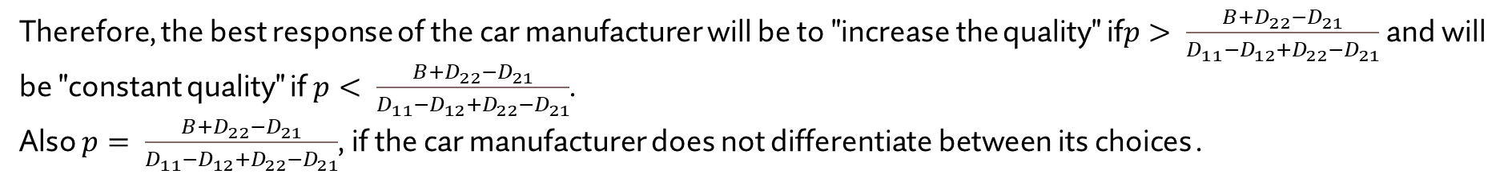
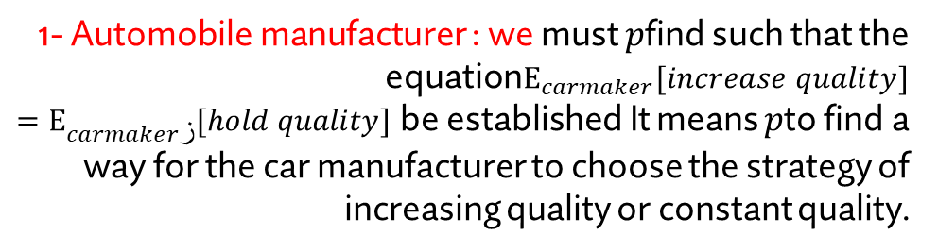
simultaneous game
Mixed Nash equilibrium
q
1 - q
Note: $p$We consider the probability of the Parliament's willingness to import and the probability of the automaker's willingness to
 | Increase quality | Consistent quality
Importation | $$C_{1}+a−s, D_{11}−B$$ | $$C_{2}, D_{12}$$
Import ban | $$a, D_{21}−B$$ | $$0, D_{22}$$
p
1- Automobile manufacturer : we must $p$find such that the equation$E_{carmaker}[increase quality]=E_{carmakerز}[hold quality]$ be established It means $p$to find a way for the car manufacturer to choose the strategy of increasing quality or constant quality.
1 - p
$p\left(D_{11}−B\right)+\left(1−p\right)\left(D_{21}−B\right)=pD_{12}+\left(1−p\right)D_{22}⇒p= \frac{B+D_{22}−D_{21}}{D_{11}−D_{12}+D_{22}−D_{21}}$
Therefore, the best response of the car manufacturer will be to "increase the quality" if$p> \frac{B+D_{22}−D_{21}}{D_{11}−D_{12}+D_{22}−D_{21}}$ and will be "constant quality" if $p< \frac{B+D_{22}−D_{21}}{D_{11}−D_{12}+D_{22}−D_{21}}$.
Also $p= \frac{B+D_{22}−D_{21}}{D_{11}−D_{12}+D_{22}−D_{21}}$, if the car manufacturer does not differentiate between its choices .

Slide 18
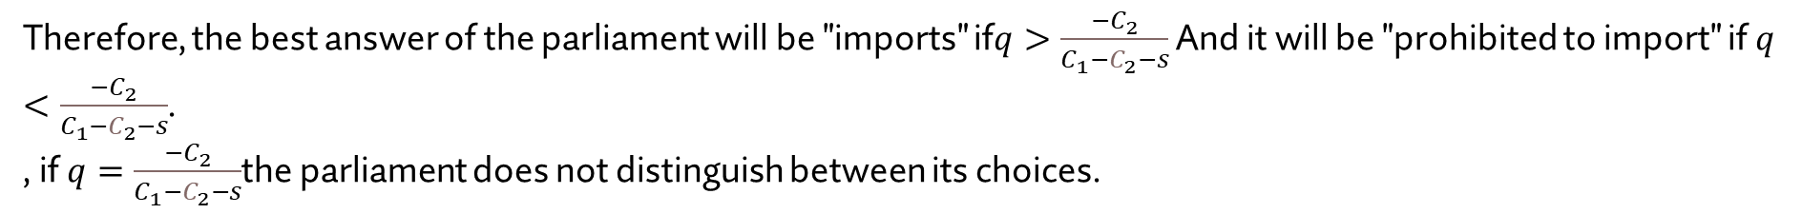
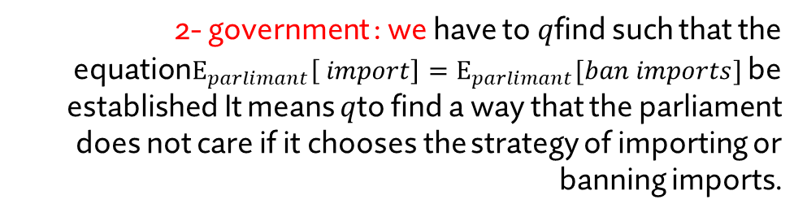
simultaneous game
Mixed Nash equilibrium
q
1 - q
 | Increase quality | Consistent quality
Importation | $$C_{1}+a−s, D_{11}−B$$ | $$C_{2}, D_{12}$$
Import ban | $$a, D_{21}−B$$ | $$0, D_{22}$$
p
2- government : we have to $q$find such that the equation$E_{parlimant}\left[ import\right]=E_{parlimant}[ban imports]$ be established It means $q$to find a way that the parliament does not care if it chooses the strategy of importing or banning imports.
1 - p
$q\left(C_{1}+a−s\right)+\left(1−q\right)C_{2}=qa+0⇒q=\frac{−C_{2}}{C_{1}−C_{2}−s}$
Therefore, the best answer of the parliament will be "imports" if$q>\frac{−C_{2}}{C_{1}−C_{2}−s}$ And it will be "prohibited to import" if $q<\frac{−C_{2}}{C_{1}−C_{2}−s}$.
, if $q=\frac{−C_{2}}{C_{1}−C_{2}−s}$the parliament does not distinguish between its choices.

Slide 19
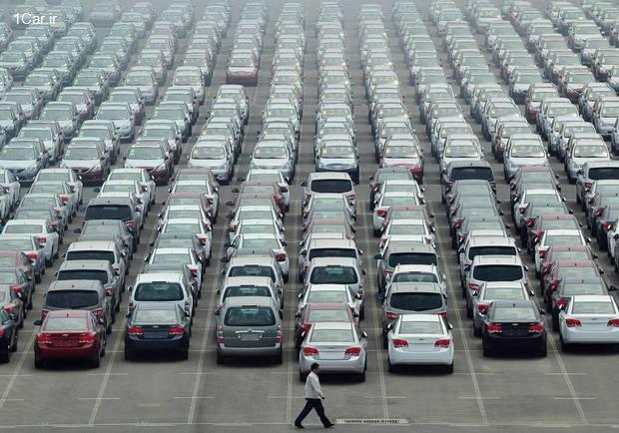
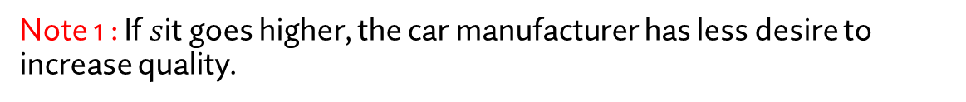
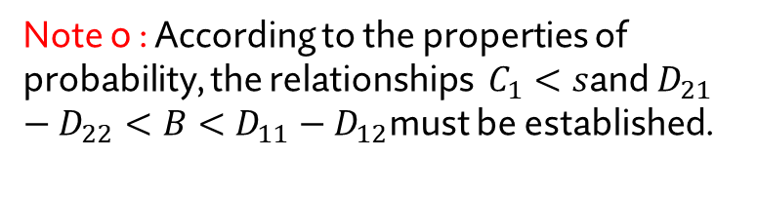
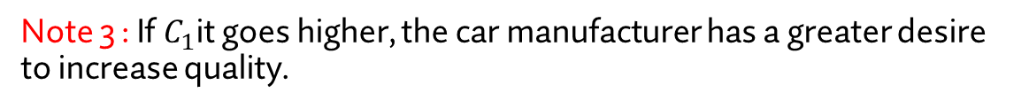
simultaneous game
Mixed Nash equilibrium
The mixed Nash equilibrium of this strategic model is as follows:
$((\frac{B+D_{22}−D_{21}}{D_{11}−D_{12}+D_{22}−D_{21}}$,$\frac{D_{11}−D_{12}−B}{D_{11}−D_{12}+D_{22}−D_{21}}),(\frac{−C_{2}}{C_{1}−C_{2}−s},\frac{C_{1}−s}{C_{1}−C_{2}−s}))$
Note 0 : According to the properties of probability, the relationships $C_{1}<s$and $D_{21}−D_{22}<B<D_{11}−D_{12}$must be established.
Note 1 : If $s$it goes higher, the car manufacturer has less desire to increase quality.
Note 2 : If $B$it goes higher, the parliament is more willing to import.
Note 3 : If $C_{1}$it goes higher, the car manufacturer has a greater desire to increase quality.

Slide 20

Extensive game

Slide 21
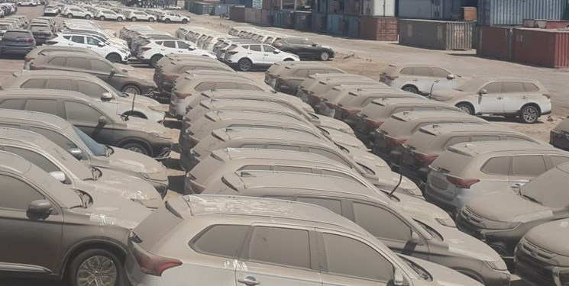
Extensive game
: The (positive) value of the parliament's desire to increase domestic production a reminder
: Amount of cost to increase car quality by car manufacturer B reminder
The most important influencing factors in choosing two players :
a, b, s
: amount of (negative) shame of the parliament in exchange for harming the car manufacturer s reminder

Slide 22

Extensive game
Strategic game model
Players: government and the automobile manufacturer
Final histories: (increasing quality , import) (increasing quality , import ban) (fixed quality , import) (fixed quality , import ban)
Player function: If the car manufacturer starts the game (otherwise vice versa):
P() = car maker , P( quality increase ) = assembly , P( fixed quality ) = assembly
Preferences: We denote the parliament's preference with u ₁ and the automobile manufacturer's preferences with u _{2 .}
u ₁ ( import , quality increase ) = C ₁ + a –s, u ₁ ( import ban , quality increase ) = a , u ₁ ( import , fixed quality ) = C ₂ , u ₁ ( import ban , fixed quality ) = 0
u ₂ ( import , quality increase ) = D ₁₁ - B , u ₂ ( import ban , quality increase ) = D ₂₁ - B, u ₂ ( import , fixed quality ) = D ₁₂ , u ₂ ( import ban , fixed quality ) = D ₂₂

Slide 23
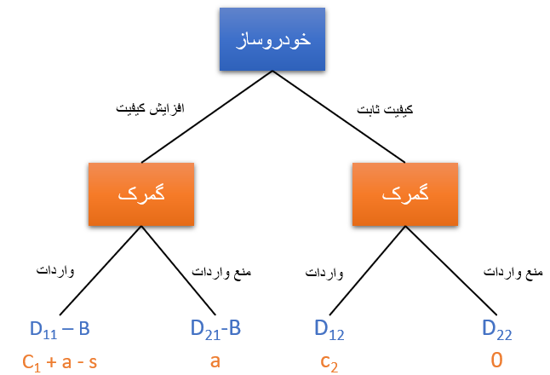
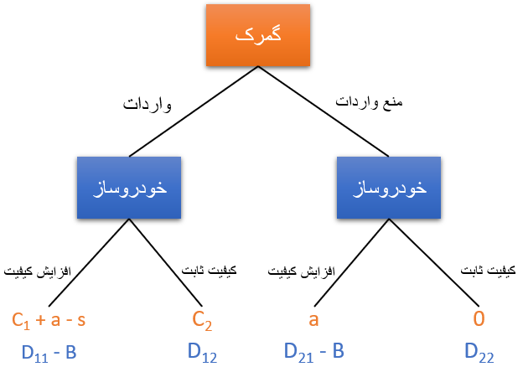

Extensive game
Different game forms developed
Initiator: Automaker
Initiator: government
D ₂₁ > D ₂₂ > D ₁₁ > D ₁₂ ; D ₁₁ – D ₁₂ > D ₂₁ – D ₂₂ reminder

Slide 24
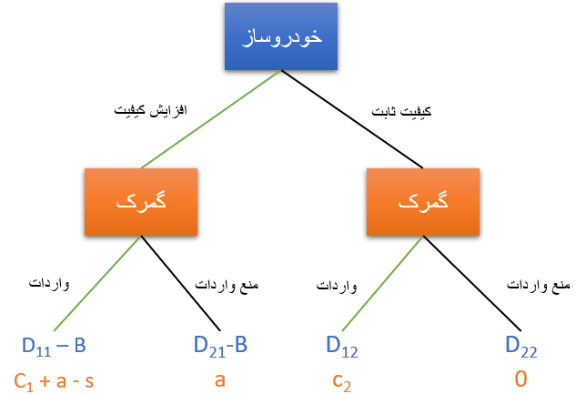
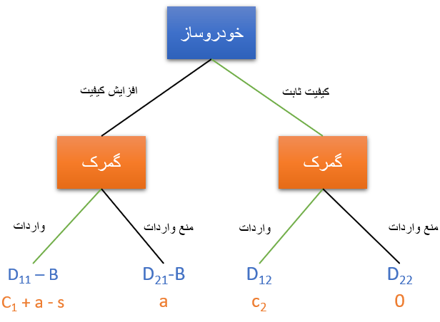
Extensive game
The game model developed if the car manufacturer starts the game:
i . C ₁ + a – s > a ➔ C ₁ > s
1) D ₁₁ – B > D ₁₂ ➔ B < D ₁₁ – D ₁₂
2) D ₁₁ – B < D ₁₂ ➔ B > D ₁₁ – D₁₂
Final output: (imports , quality increase)
Final output: (imports , fixed quality)

Slide 25
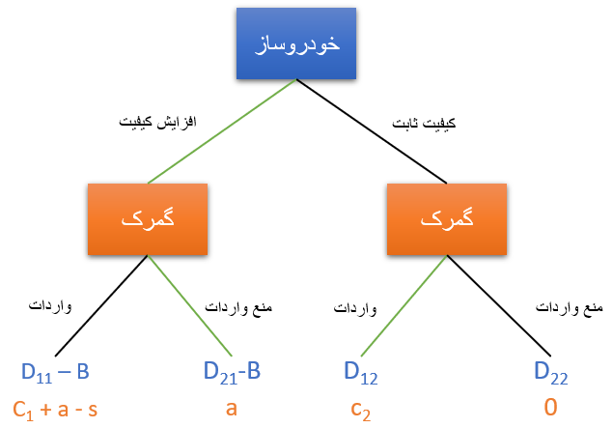
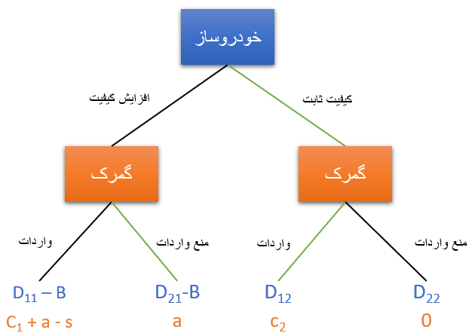
Extensive game
The game model developed if the car manufacturer starts the game:
ii. C ₁ + a – s < a ➔ C ₁ < s
1) D ₂₁ – B > D ₁₂ ➔ B < D ₂₁ – D ₁₂
2) D ₂₁ – B < D ₁₂ ➔ B > D ₂₁ – D ₁₂
Final output: (import ban , quality increase)
Final output: (imports , fixed quality)

Slide 26
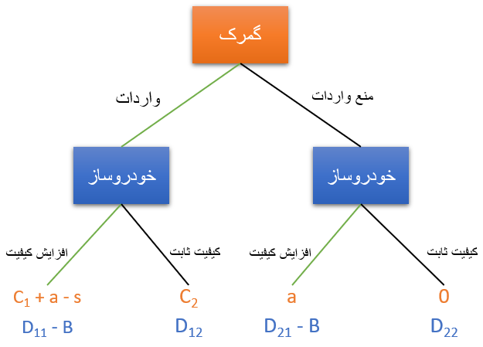
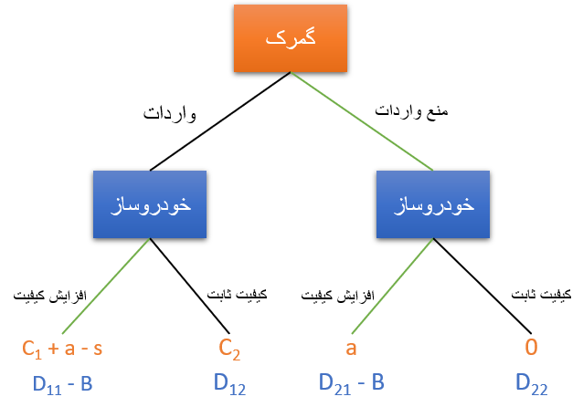
Extensive game
The developed game model if the parliament starts the game:
i . B < D ₂₁ – D ₂₂ < D ₁₁ – D ₁₂
1) C ₁ + a – s > a ➔ s < C ₁
2) C ₁ + a – s < a ➔ s > C ₁
Final output: (increase in quality , import)
Final output: (increasing quality , banning imports)

Slide 27
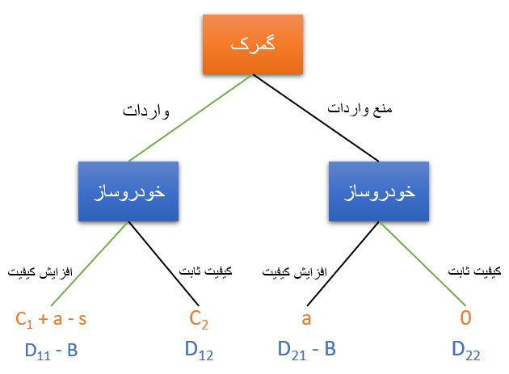
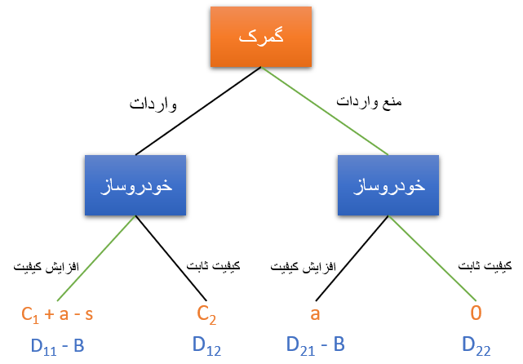
Extensive game
The developed game model if the parliament starts the game:
ii. D ₂₁ – D ₂₂ < B < D ₁₁ – D ₁₂
1) C ₁ + a – s > 0
2) C ₁ + a – s < 0
Final output: (increase in quality , import)
Final output: (constant quality , import ban)

Slide 28
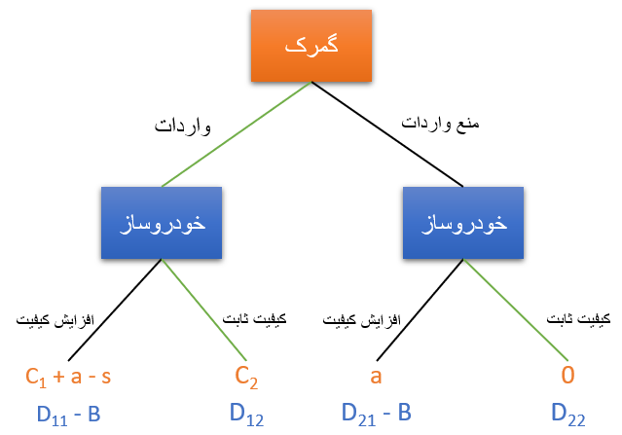
Extensive game
The developed game model if the parliament starts the game:
iii. D ₂₁ – D ₂₂ < D ₁₁ – D ₁₂ < B
1) C ₂ > 0
Final output: (fixed quality , import)

Slide 29
Conclusion
Conclusion
The ideal condition that is proposed is that B is in its lowest state and the values of a and s are in the middle state.
One of the ways that automakers can control B is to use young and expert internal forces and knowledge-based companies.
Less than one percent of the profit from the sale of domestic cars is spent on research and development.
If B is in its lowest state and the government and parliament are composed of members who prefer national pride over financial income, then most of the problems of the domestic automobile industry will be solved. Creating a competitive environment can also be a problem solver.

Slide 30

thanks for your attention

